Slide 1
csWeb in Expe42/36 Erik Vullings, TNO

Slide 2
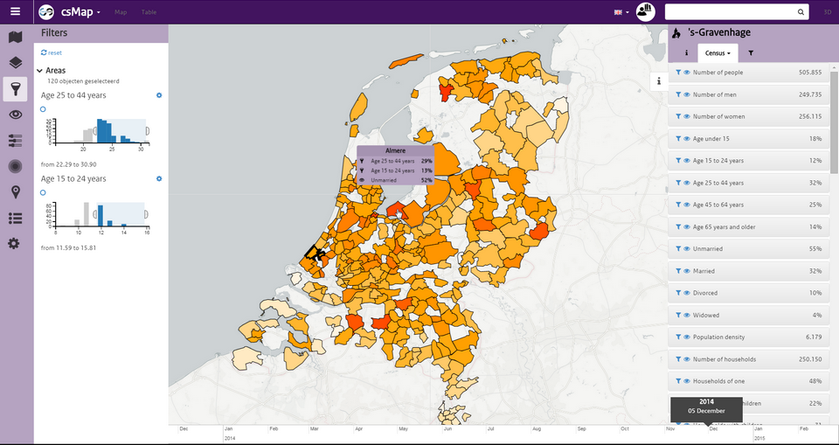
What is csWeb
csWeb, or CommonSense web app, is an open source GIS framework. It can be used to easily create your own apps.
Its strength are in visualising, analysing and modelling of geographic data.
Used for
Common Operational Picture
Safety and Security operations
Public Health, Urban Planning & City dashboard
https://github.com/TNOCS/csWeb

Slide 3
Why csWeb?
In a crisis, one CM professional often has to manage many (geo-) sources of information, visualize them to improve SA, as well as analyze and understand their impact (what-if analysis).
csWeb improves situational awareness
Displays static information: Critical infrastructure, risk locations, care and cure institutions, etc.
Displays dynamic information: flooding status or simulation, locations of resources, etc.
Collaborative editing of map layers
Create and show non-geographic content (presentations, logs, event), potentially on a timeline
Perform what-if analysis and compute chain-effects of CI failure

Slide 4
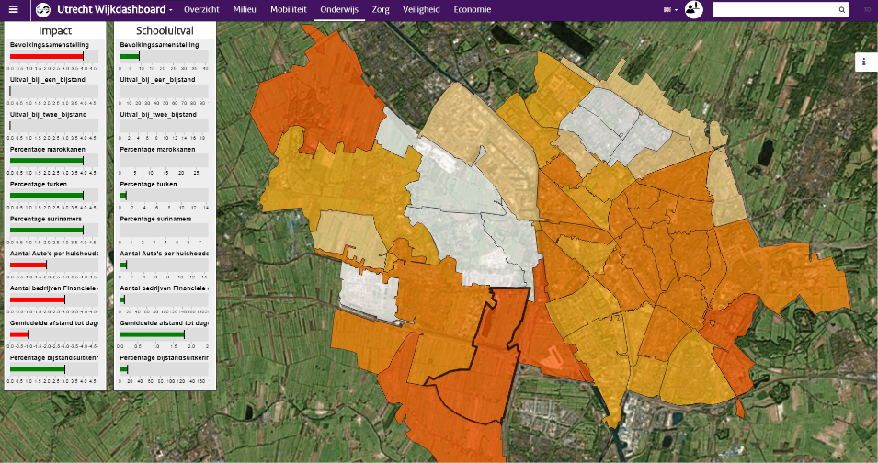
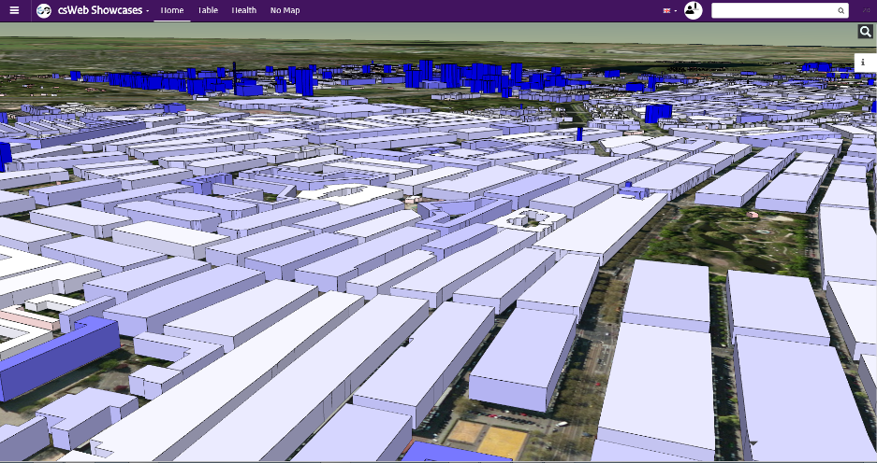
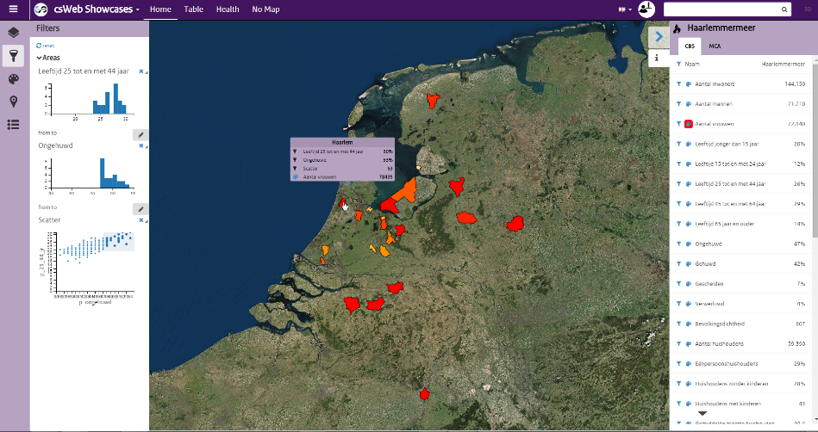
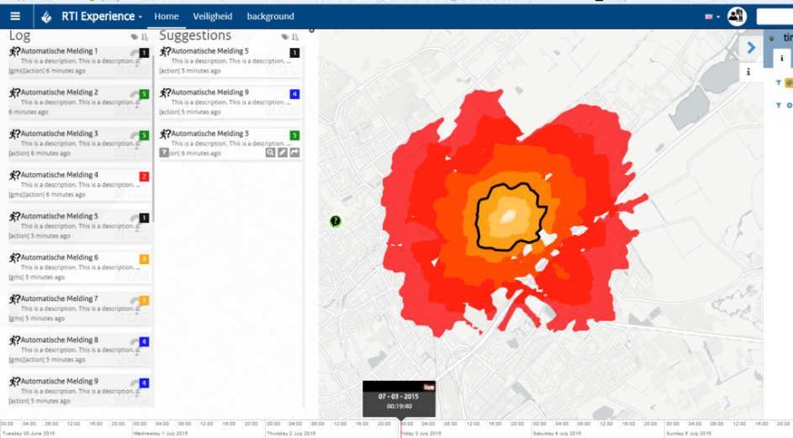
csWeb at a glance
Dashboards and widgets
3D visualization
Filtering and styling information
Event logs and tooling e.g. accessibility layer

Slide 5
csWeb in EXPE42/36
csWeb
Crowdtasker
MEGO
(flooding)
OPERATIONS
CIS
GEO
STORE
csWeb-sim
Simulation Models
PLANNING
Flooding
Road accessibility
Train accessibility
Electricity status
CI status
Communications
Simulation
Manager

Slide 6
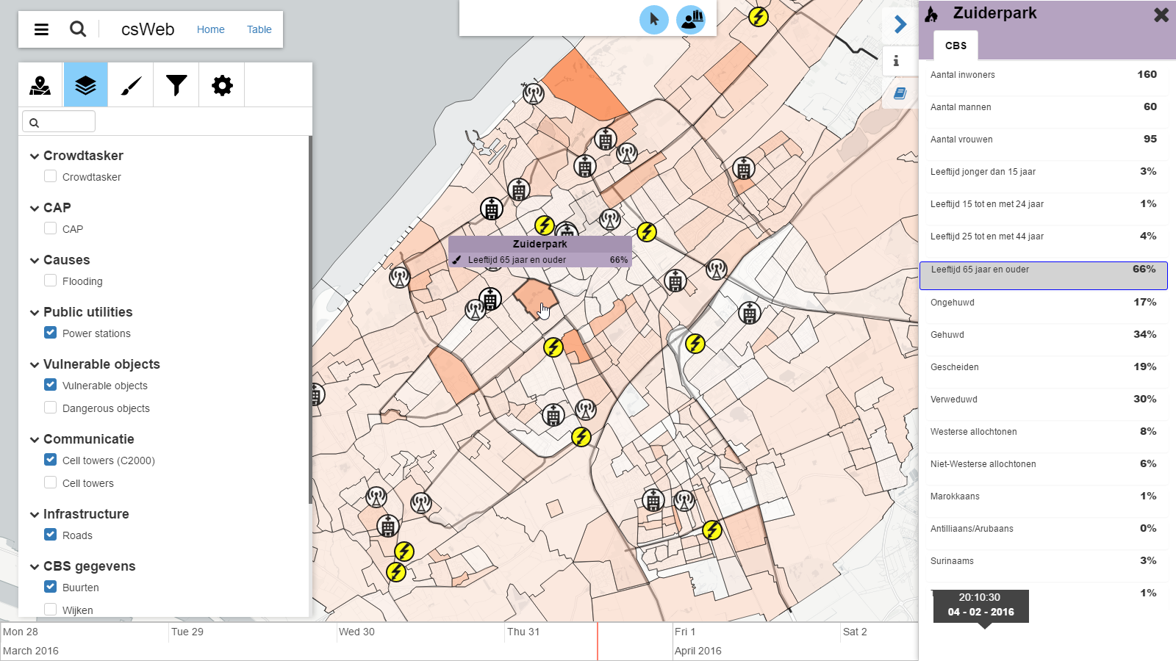
COP view for OPERATIONS

Slide 7
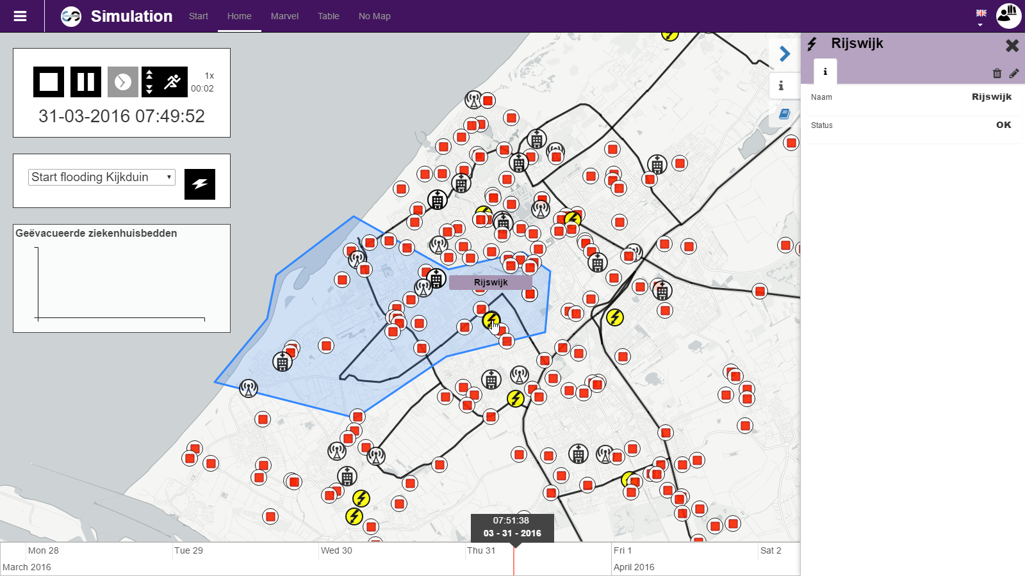
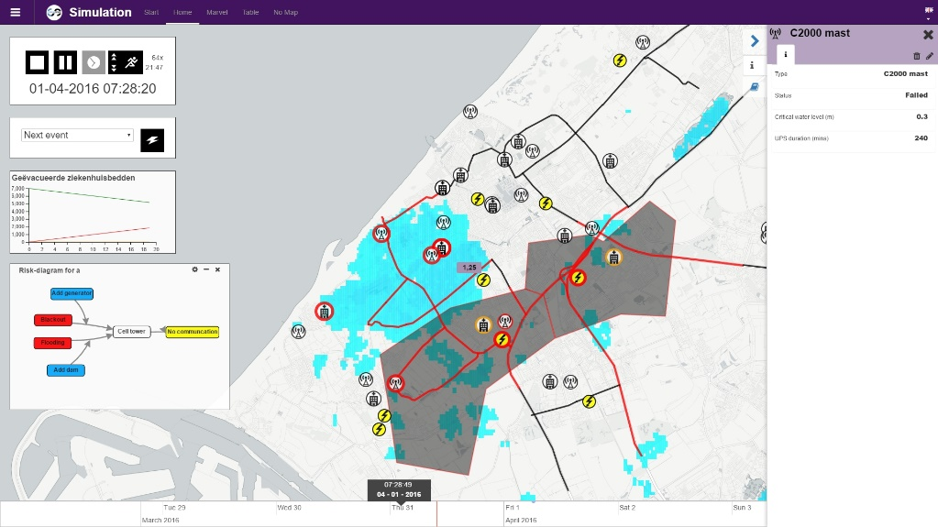
csWeb SIM view for PLANNING
BEFORE
AFTER

Slide 8


Thank you!
Erik Vullings, TNO
This project has received funding from the European Union’s Seventh Framework Programme for research, technological development and demonstration under grant agreement n° 607798

Slide 9
Get involved!

